Slide 1
Introduction to TensorFlow
Alexey Svyatkovskiy

Slide 2
Outline
TensorFlow architecture and primitives
TF constants, variables and placeholders. Session
Installing TensorFlow locally and on Princeton University clusters
TF deep-dive
Hands-on Tensorboard demo: debugging CNN
Scalar variable summaries, histograms, embedded visualization
(future) API overview
tensorflow.layers module, estimators, Keras
Distributed TensorFlow
ClusterSpecs and Servers
Scheduling with SLURM

Slide 3
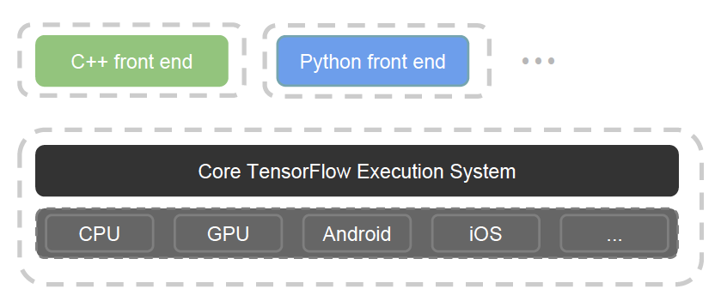
TensorFlow architecture
TensorFlow is a Python Library that allows users to express arbitrary computation as a graph of data flows. Nodes in this graph represent mathematical operations (ops), whereas edges represent data that is communicated from one node to another
Computation is defined as Directed Acyclic Graph
TensorFlow tensors = multidimensional arrays
Different front-ends: Python and C++ as of today
Core written in C++

Slide 4
TensorFlow primitives: constants, variables
Constants: operations that do not need an input
Variables: in-memory buffers that contain tensors, they are present across multiple executions of a graph
Variables must be explicitly initialized before a graph is used for the first time
We can use gradient methods to modify variables after each iteration as we search for a model’s optimal parameter settings
We can save the values stored in variables to disk and restore them for later use.
Following creates a variable:

Slide 5
TensorFlow primitives: constants, variables
Similarly to NumPy, one can use a set of predefined functions to create some common tensors:

Slide 6
TensorFlow operations
On a high-level, TensorFlow operations represent abstract transformations that are applied to tensors in the computation graph. Operations may have attributes that may be supplied before or during runtime.
An operation consists of one or more kernels, which represent device-specific implementations. For example, an operation may have separate CPU and GPU kernels because it can be more efficiently expressed on a GPU.
To provide an overview of the types of operations available, we include a table from the original TensorFlow white paper detailing the various categories of operations in TensorFlow.
Following table summarizes the mathematical ops available in Tensorflow:
See more details at:
Notes:
https://www.tensorflow.org/api_guides/python/control_flow_ops
https://www.tensorflow.org/api_guides/python/math_ops

Slide 7
TensorFlow placeholders
A variable is meant to be initialized only once. If we need to feed some external input to our calculation, we would need to use something that we could populate every iteration.
TensorFlow solves this problem using a construct called a placeholder. A placeholder is instantiated as follows and can be used in operations just like ordinary TensorFlow variables and tensors.
You supply feed data as an argument to a run() call. The feed is only used for the run call to which it is passed. The most common use case involves designating specific operations to be "feed" operations by using tf.placeholder() to create them:
A placeholder() operation generates an error if you do not supply a feed for it

Slide 8
Installing TensorFlow
Available via pip:
pip install –updagrade tensorflow
If that does not work, either upgrade pip or point to the googleapis website:
export TF_BINARY_URL=https://storage.googleapis.com/tensorflow/linux/cpu/tensorflow-1.0.0-cp27-none-linux_x86_64.whl
pip install --user --upgrade $TF_BINARY_URL

Slide 9
Installing TensorFlow
Recommended way to install TensorFlow on Princeton University clusters: use distributions build by Josko:
export TF_BINARY_URL = http://tigress-web.princeton.edu/~plazonic/tensorflow/rhel6/tensorflow_pkg_gpu/tensorflow-1.0.0-cp27-cp27mu-linux_x86_64.whl
pip install –user $TF_BINARY_URL

Slide 10
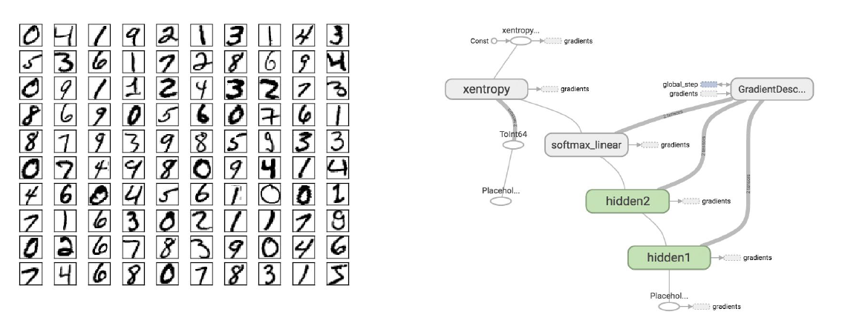
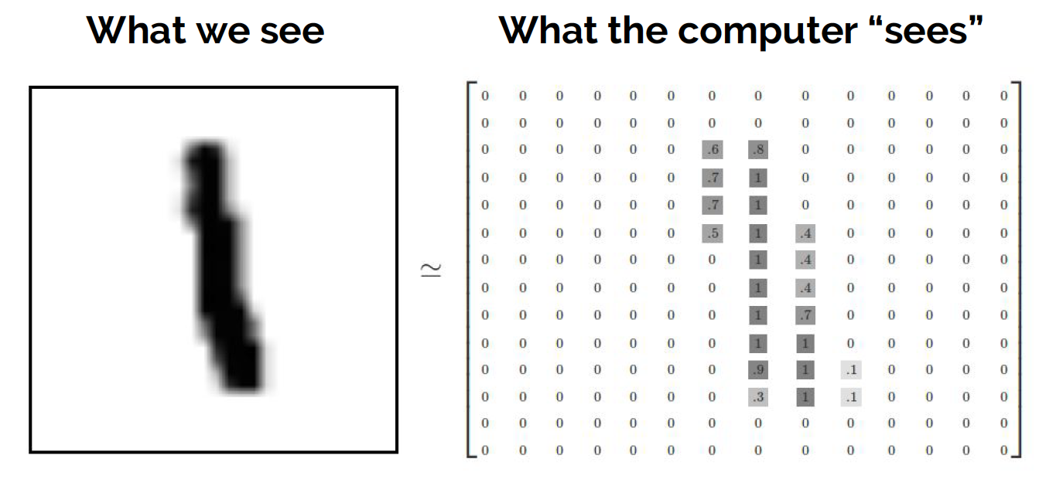
Hands-on Tensorboard demo
Our next task is a "Hello world" of deep learning MNIST handwritten digit classification. Given enough images and labels, we would like to figure out the weights and biases so the model can correctly identify digits.

Slide 11
(DEMO)

Slide 12
Overview of APIs

Slide 13
tensorflow.layers module
Details: https://www.tensorflow.org/api_guides/python/contrib.layers
Layers module provides a higher-level API for tensorflow, where one does not have to multiply matrices and vectors, but think in terms of layers. For instance, for the CNN example from the demo this would be:
conv 5x5 (relu)
x = tf.layes.conv_2d(x, kernel_size=[5,5,…])
x = tf.layes.max_pooling2d(x, kernel_size=[2,2,…])
x = tf.layes.conv_2d(x, kernel_size=[5,5,…])
x = tf.layes.max_pooling2d(x, kernel_size=[2,2,…])
x = tf.layers.dense(x, activation_fn=tf.nn.relu)
x = tf.layers.dropout(x,0.5)
x = tf.layers.dense(x)
max pool 2x2
conv 5x5 (relu)
max pool 2x2
dense (relu)
dropout 0.5
dense (linear)

Slide 14
Estimator API and Keras
Training loop
fit()
Model
Evaluation loop (cross validation)
Input, labels
evaluate()
model_fn
Predictions
predict()

Slide 15
Distributed TensorFlow
A TensorFlow "cluster" is a set of "tasks" that participate in the distributed execution of a TensorFlow graph. Each task is associated with a TensorFlow "server", which contains a "master" that can be used to create sessions, and a "worker" that executes operations in the graph. A cluster can also be divided into one or more "jobs", where each job contains one or more tasks.
To create a cluster, you start one TensorFlow server per task in the cluster. Each task typically runs on a different machine, but you can run multiple tasks on the same machine (e.g. to control different GPU devices). In each task, do the following:
Create a tf.train.ClusterSpec that describes all of the tasks in the cluster. This should be the same for each task.
Create a tf.train.Server, passing the tf.train.ClusterSpec to the constructor, and identifying the local task with a job name and task index
More details: https://www.tensorflow.org/deploy/distributed

Slide 16
Distributed TensorFlow with SLURM
Explain what data parallel training is, synchronous training
Q: What do we need to know to construct a ClusterSpec and Server objects?
A: list of parameter server hosts and a list of worker hosts, total number of allocated hosts
SLURM environmental variables SLURM_NODELIST, SLURM_NPROCS provide this information
Use MPI, SLURM to schedule TensorFlow on the cluster
num_workers_per_host = NUM_GPUS
tasks_per_node = task_num / num_hosts
task_num = comm.Get_size()
Tasklist -> expand_hostlist( os.environ['SLURM_NODELIST'])

